Slide 1
“APT” Bio-Insecticide Technology
Cultured Microbiome Microbial Insights
Smarter Sustainable solutions
GoK-Unnati winner
Startup Seed Fund Grant
Technology Accelerator winner
Powered by FICCI and Texas IC² Institute
Business Development Grant
ACIR & American Center
Elevate Winner
DIPP recognized startup / Udyog Aadhar registered / NIESBUD Certified
Dr. Mahadeva Swamy H M,
CEO & Director, Crop Domain

Slide 2
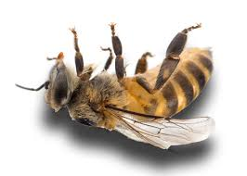
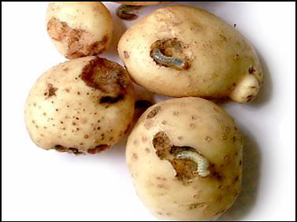
Have you experienced it ?
Global pest
India: ”National Pest”
White grub infestation
in arecanut
White grub
infestation in Sugarcane
Pesticide residues
is a major environmental challenge
Loss of biodiversity
underpins the health of the planet
White grub infestation
in Potato
Pollinators Matters
Pesticide poisonings is increasing

Slide 3
What's more!
Search result not found on given search criteria
Uncontrolled spread, Untimely and Unwanted application
Farmers and industries want ‘eco-friendly, sustainable alternatives’

Slide 4
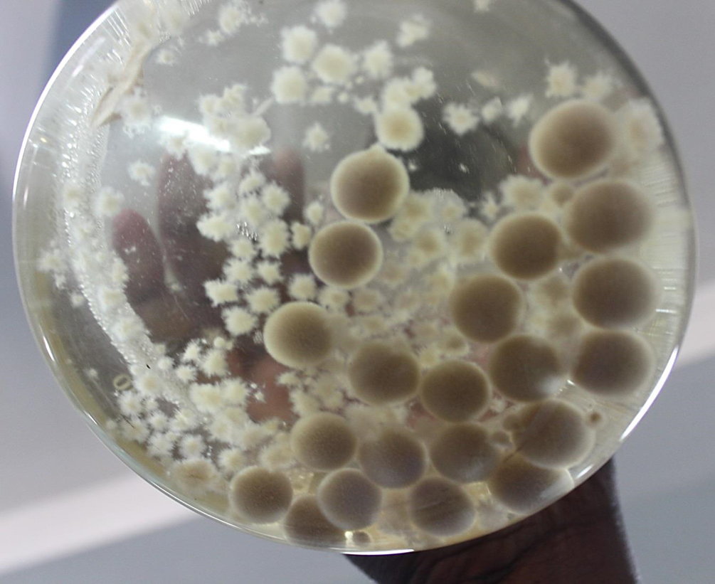
Solution
Accurate, lethal, Improved efficacy
@
60% cheaper
than others
due to its
Unique elite novel microbial toxins bio formulations
Consider a future where ecologically friendly biopesticides boost harvests while preserving biodiversity...

Slide 5
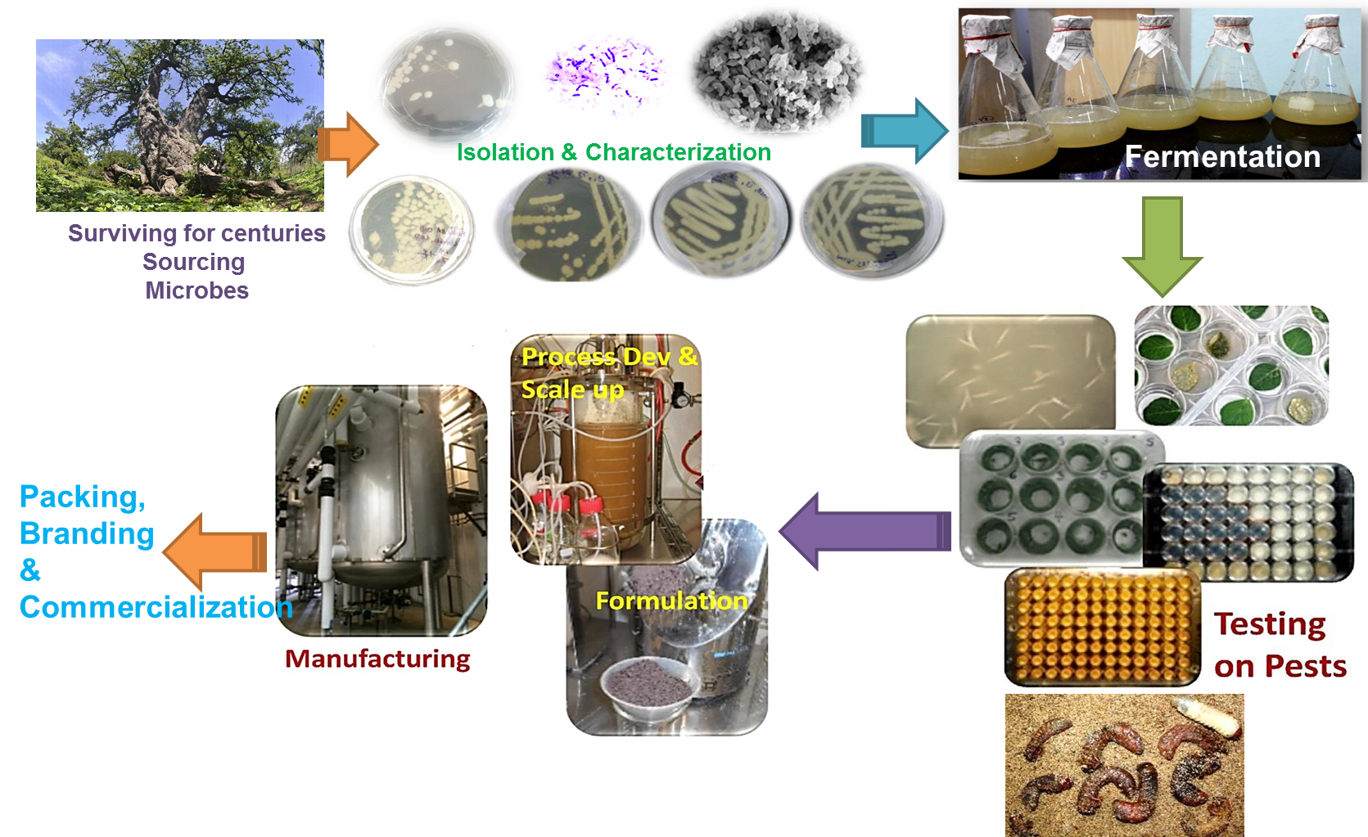
Our approach-Protect Crops to Boost Profitability

Slide 6
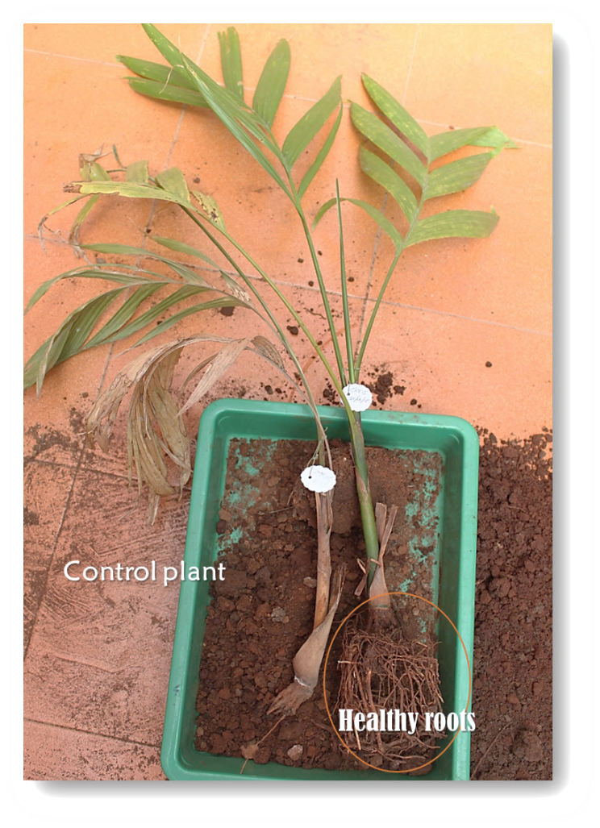
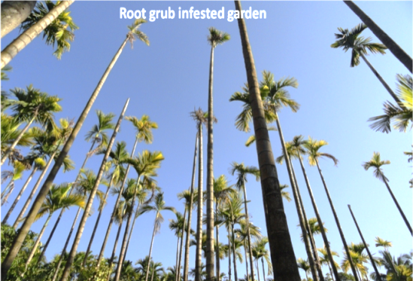
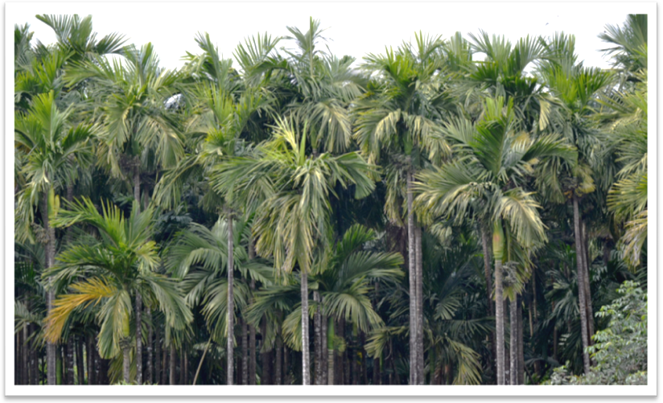
Divya Aushad
Fully developed Biopesticide in granular form
Applications
So Simple,
Yet So Powerful
Recovery of damaged roots
$ 36,684
Research
Grant
Transformations

Slide 7
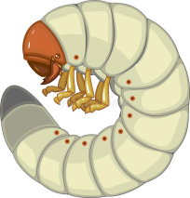
Novelty
Lethal, Fast, Accurate
Economic Viability
Social Acceptability
Environmental Safety
Increase native bees populations
More Root Growth
Less microbes
Host Protection
Nutrient Uptake
Lethal to grubs
Pest Resistance
Loss biodiversity
Enhanced Root Microbiome

Slide 8
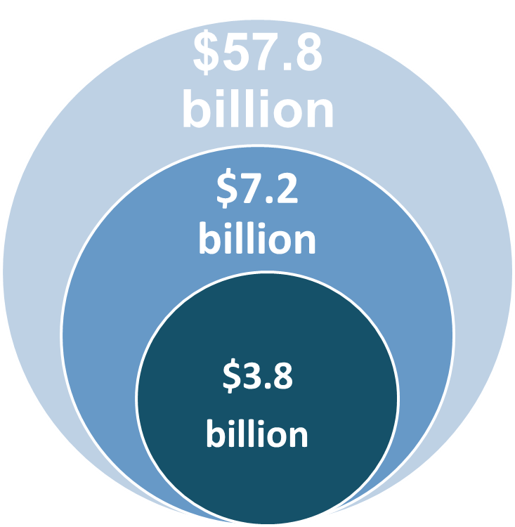
Global Market
Huge Demand supply-Gap
TAM
Biologicals : Double digit CAGR
Versus
Global Crop Protection : 3% CAGR
SAM
SOM
One-third of crop protection active ingredients today are biologicals
Source: Dunham Trimmer, Global Biocontrol Report, 2019; Modorintelligence.com; Phillips McDougal 2019 maker overview; Phillips McDougal 2018 products

Slide 9
Domestic targets ($M)
Horticultural Crops
$23
Sugar Cane
$ 209
High
Arecanut
$ 190
Potato
$ 127
Coconut
$80
Coffee, Cocoao
Horticulture Nurseries
$26
Competitive Fit
Tobacco
$170
Paddy
$80
Vegetable crops
$20
Ground Nut
$40
Maize
Ginger
$104
Primary Focus Crops
Secondary Focus Crops
Low
Market Attractiveness
High

Slide 10
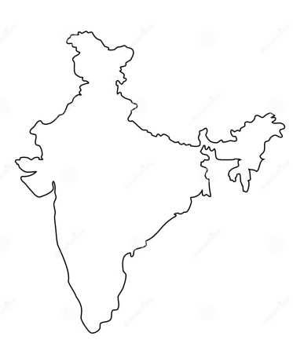
Competition
Bio efficacy
Affordability
Bayer
Rs 6520 per annum
Dupont
Rs 8700 per annum
Benzer crop science
Rs 5000 per annum
Romvijay biotech
Rs 3500 per annum
Crop domain
Rs 1500 per annum
Opportunity
Barriers
Indigenous
Import substitute
$ Export potential $
sustainable
Improving soil health, Crop quality & safety
One grade, many uses
Opens new markets
Unique formulations involved
Time saving, cost saving

Slide 11
Business model & Outlook
Revenue streams
Growth through sustainability
Regional & National Partners Globally
Sales through Distribution and Retail Channels
Evolution from technology focus to commercial-scale operations
Development
Validation
On-farm
Manufacturing
Deployment
Core research &
Characterization
Lab + Field
Efficacy
Safety
Affordability
Sustainability
Ease of use
Large-scale demonstrations
Lab scale
Mass production
Increase volumes and yield
Deliver
Performance yield and
ROI boost
Fits with IPM
programs
Demonstrate
efficacy
BY 2024: US$50 Mn
(>10% India share)
BY 2030: 100 GWh
(2% global share)

Slide 12
This means
Famers
Must
Increase
Yields
On existing lands with less inputs, sustainable
Famer
Demand
Pest resistance
Increased cost
Hazardous
Loss of biodiversity
Pest management
Eco-friendly
Non hazardous
Value
Proposition
while
Protecting
Biodiversity
&
Lowering
Carbon
Foot print
Crop Domain
State-of-art-of-Innovations
Uniquely Meet
These Needs
sustainably
Maximize Production, ROI
and Minimize Losses
From insects, diseases
Climate change
Ag Suppliers
& Distributors
Provide farmers with tools and strategies to

Slide 13
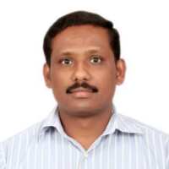
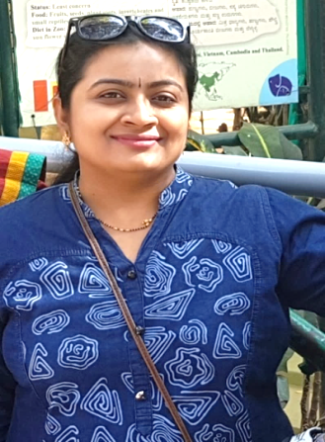
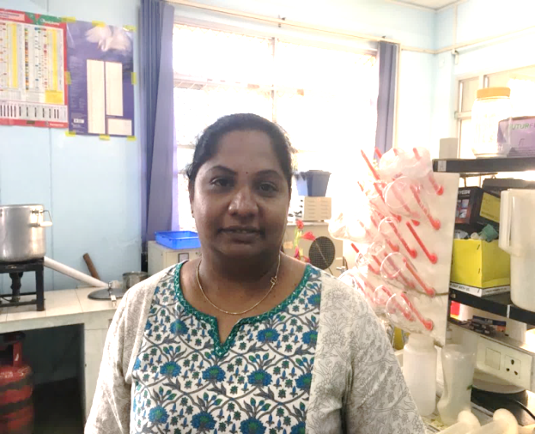
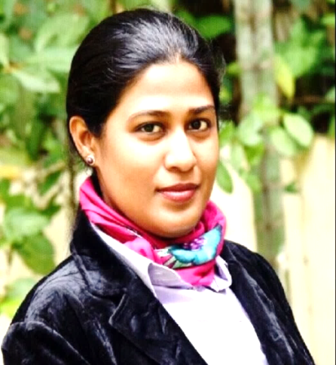
Team >50 years of experience
Dr Mahadeva Swamy MSc Agri. & PhD (Biotechnology)
12 years exp
Good at isolation of elite novel microbes
Bio formulations development
Designing field experiments
Environment enthusiast
Dr Manasa
PhD (Biotechnology)
11 years exp
Molecular biology enthusiast
Headed technical clubs in college
Dancer
Adaptability
Dr Kavitha
PhD (Biotechnology)
12 years exp
Experienced researcher
Sustainable eco-friendly solutions
Optimally utilize resources
Serving humanity
Lavanya H S
BE (E&C)
10 year exp
Critical thinker
Book worm
Thinker
Good financial and operational skills
Dr Mehjabeen
PhD Economist
6 years exp
scalability
market research
Natural farming
Social networking
Blogger
business network establishment
Social networking

Slide 14
Pipeline
Crop Domain's current R&D is largely focused on supporting existing commercial products, but we have a large pipeline of items in the works
innovation
identification
investigation
bio formulations
Regulatory
Launch
Near Term
Bio insecticide (Fall armyworm)
Field Trials to be taken up
Bio insecticide (Coffee White Stem Borer)
Field Trials to be taken up
Bio stimulant (diseases, yield and stress)
Need Cost reduction
Pipeline
Bio insecticide (Weevils, Sucking Pests)
Need Commercial partners
Bio fertilizers (Micro Nutrients)
Need manufacturing partner
Bio herbicide

Slide 15
Thank you
If Not Agriculture & Microbes, What Else?
Because if not us, who?
If not now, When?
Elite novel microbes for sustainable white grubs management & conserve biodiversity

